Slide 1
10- Quiz

Slide 2
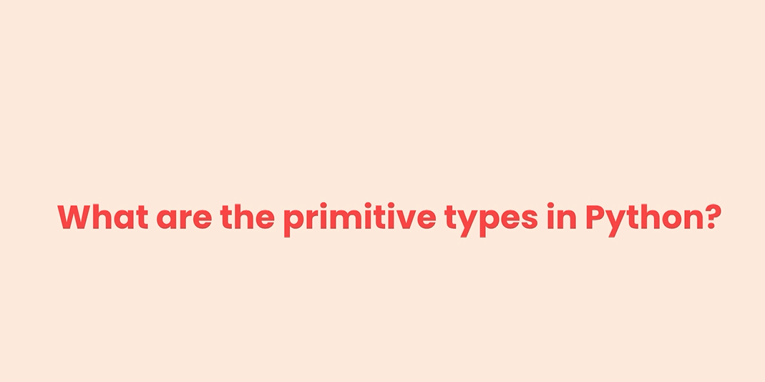
Q1

Slide 3
Q1: what are the built in primitive types in Python?
We have strings, numbers and booleans.
numbers can be integers, float's or complex numbers.

Slide 4

Q2
What do you think we will see on the terminal when we print fruit of one?

Slide 5
Q2: What do you think we will see on the terminal when we print fruit of one?
p

Slide 6

Q3
what if we add a colon,a negative one here?

Slide 7
Q3: what if we add a colon, a negative one here?
ppl

Slide 8
Q4
What is the result of this expression?

Slide 9
Q4: What is the result of this expression?

Slide 10
Q5
what do you think we will see when we print Bool of False?

Slide 11
Q5: what do you think we will seewhen we print Bool of False?
True

